Slide 1

PROJECT PROPOSAL PRESENTATION
Predictions With Global Electric Vehicle Market
PRESENTED BY : LIAO XIUYA
MATRIC NO : MCS241025

Slide 2
INTRODUCTION

Slide 3
INTRODUCTION
Since 2010, driven by technological progress, government policy support and environmental awareness, the electric vehicle industry has developed rapidly and gradually occupied the market of the automotive industry. At present, the electric vehicle market is mainly popular with pure electric vehicles (BEV), plug-in hybrid electric vehicles (PHEV), fuel cell vehicles (FCEV) and hybrid electric vehicles (HEV). This study focuses on this trend and collects a comprehensive data set on global electric vehicle sales on authoritative platforms such as kaggle and the IEA Global EV Data Explorer. Focus on data from well-known countries with high electric vehicle penetration and market influence, including China, the United States, Germany and the United Kingdom.
These data cover historical sales data, charging infrastructure and other related indicators from 2010 to 2023. This study aims to use various data analysis tools, such as predictive models, machine learning, data analysis, etc., to analyze historical data and make a rough analysis and prediction of the future development trend of the electric vehicle industry.

Slide 4
BACKGROUND
The global automotive market's shift toward electric vehicles (EVs) is driven by environmental concerns, technological advances, supportive government policies, and changes in consumer preferences. With the rapid growth of EVs since 2010, and the increasing variety of EV energy sources, which energy source will dominate the future EV market? This question is of particular concern to automotive companies, especially when it comes to their future development plans, and is also of concern to many consumers.
This study uses data science tools such as predictive modeling, machine learning, and time series analysis to analyze historical EV sales data from 2010 to 2020 and forecast future trends to 2030. The data for this study comes from Kaggle and IEA Global EV Data Explorer, focusing on major countries such as the United States, China, Germany, and Norway. This study provides stakeholders with valuable insights to respond to the changing EV market.

Slide 5
RESEARCH QUESTIONS & OBJECTIVES
Research Question
Research Objectives
How to analyze historical sales data of various types of electric vehicles to identify the main trends and patterns that have emerged since 2010?
How to predict future trends: Accurate predictions of future electric vehicle development trends?
How to deliver strategic insights like advise automakers, policymakers, and investors to support informed decision-making and strategic planning?
To Analyze historical trends: Examine the sales data of various types of electric vehicles in major countries around the world from 2010 to 2020 to identify and analyze the main trend characteristics.
To Forecasting future sales: Leverage machine learning and time series analysis to develop forecasting models to forecast EV sales trends through 2030.
To Evaluate influencing factors: Evaluate the impact of technological advances, government policies, market dynamics, and consumer preferences on all types of electric vehicles.
To Deliver strategic insights: Advise automakers, policymakers, and investors to support informed decision-making and strategic planning.

Slide 6
LITERATURE REVIEW

Slide 7
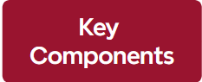
LITERATURE REVIEW
Electrical Vehicle Market
Market Trend and Forecast
Classification Technique

Slide 8
METHODOLOGY

Slide 9
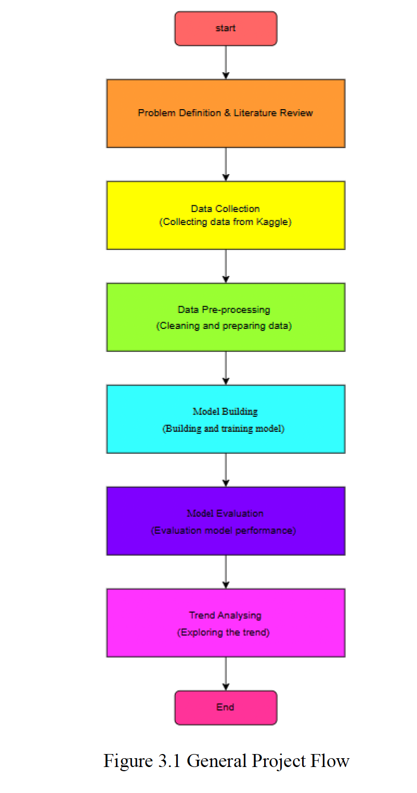
METHODOLOGY OVERVIEW

Slide 10
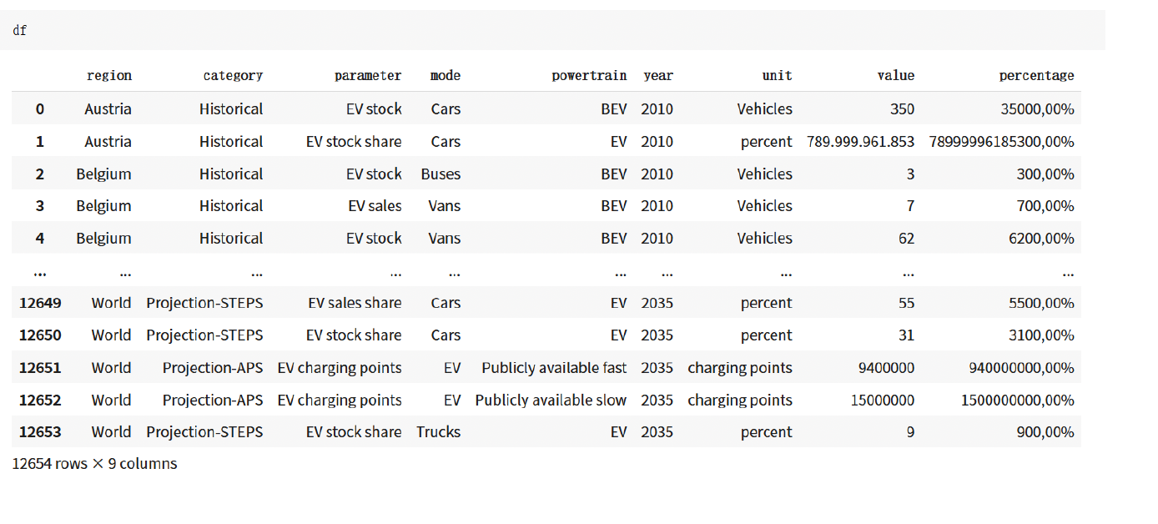
Dataset

Slide 11
INITIAL FINDING

Slide 12
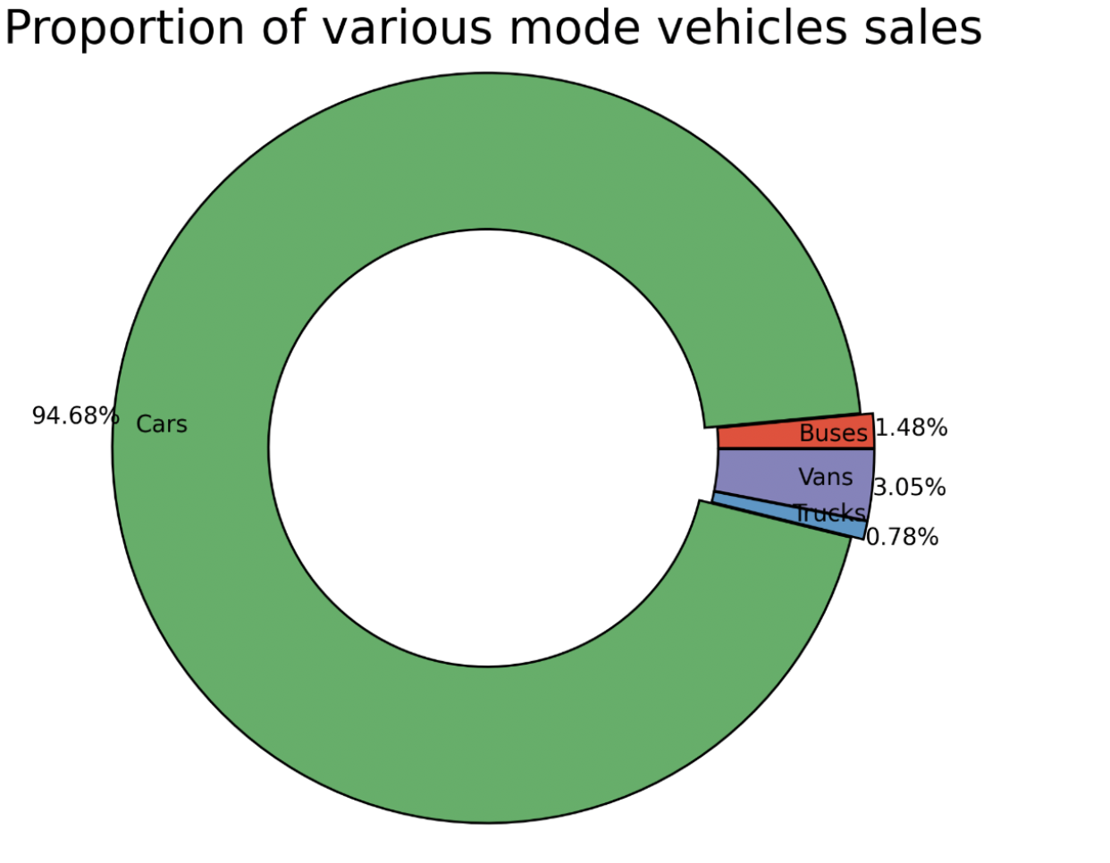
Proportion of Various Mode Vehicles Sales

Slide 13
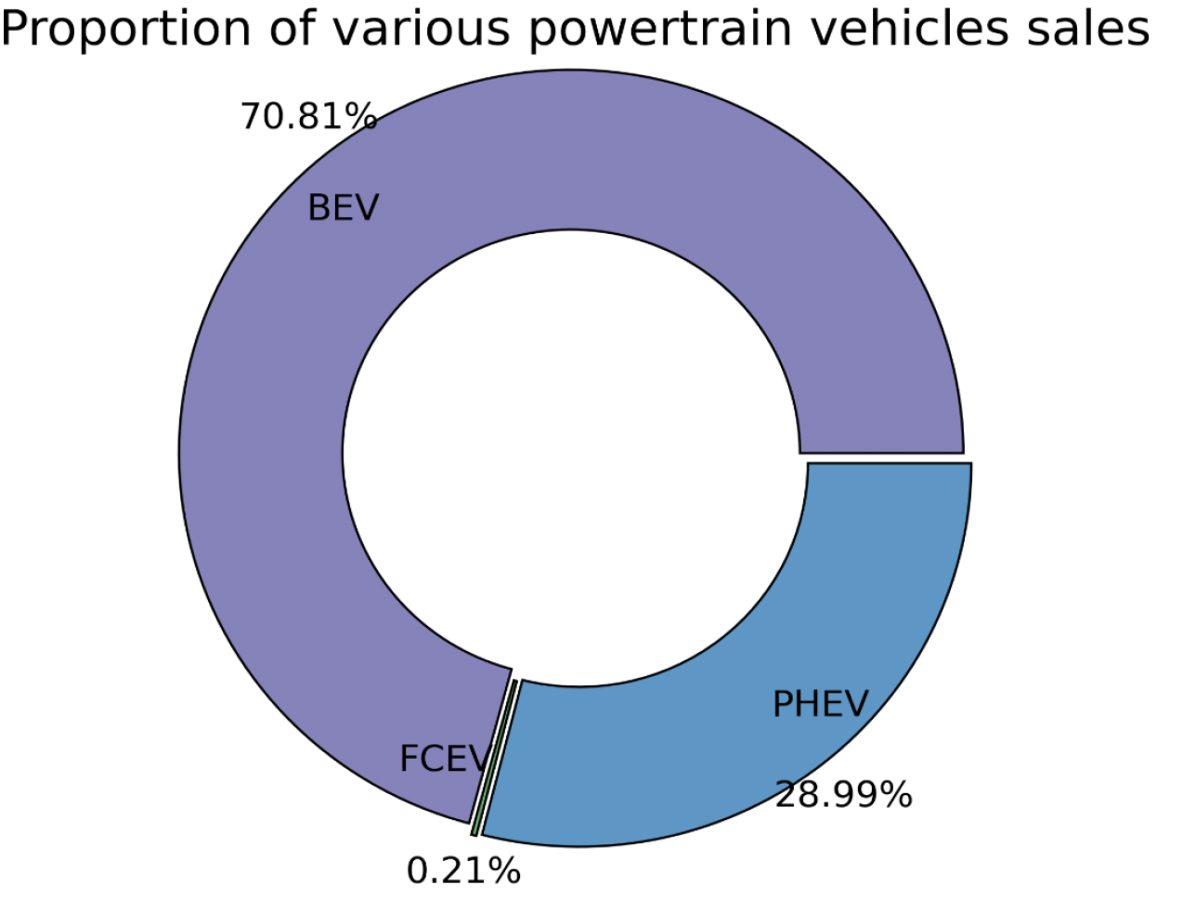
Proportion of Various Powertrain Vehicles Sales

Slide 14
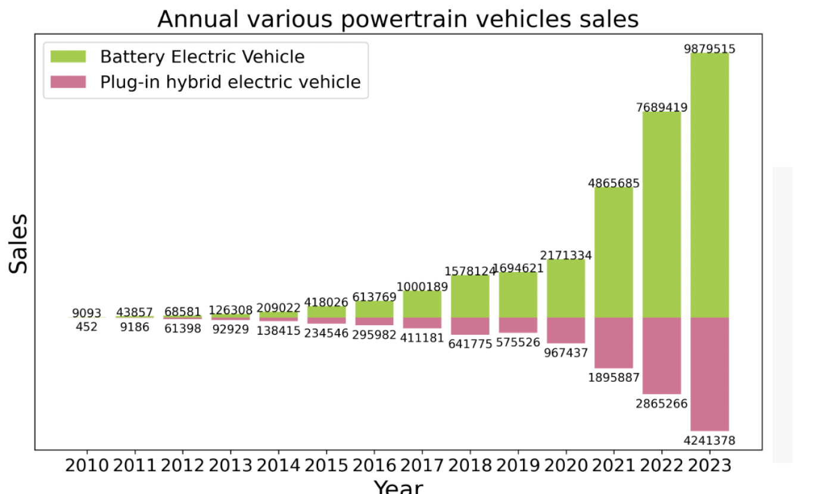
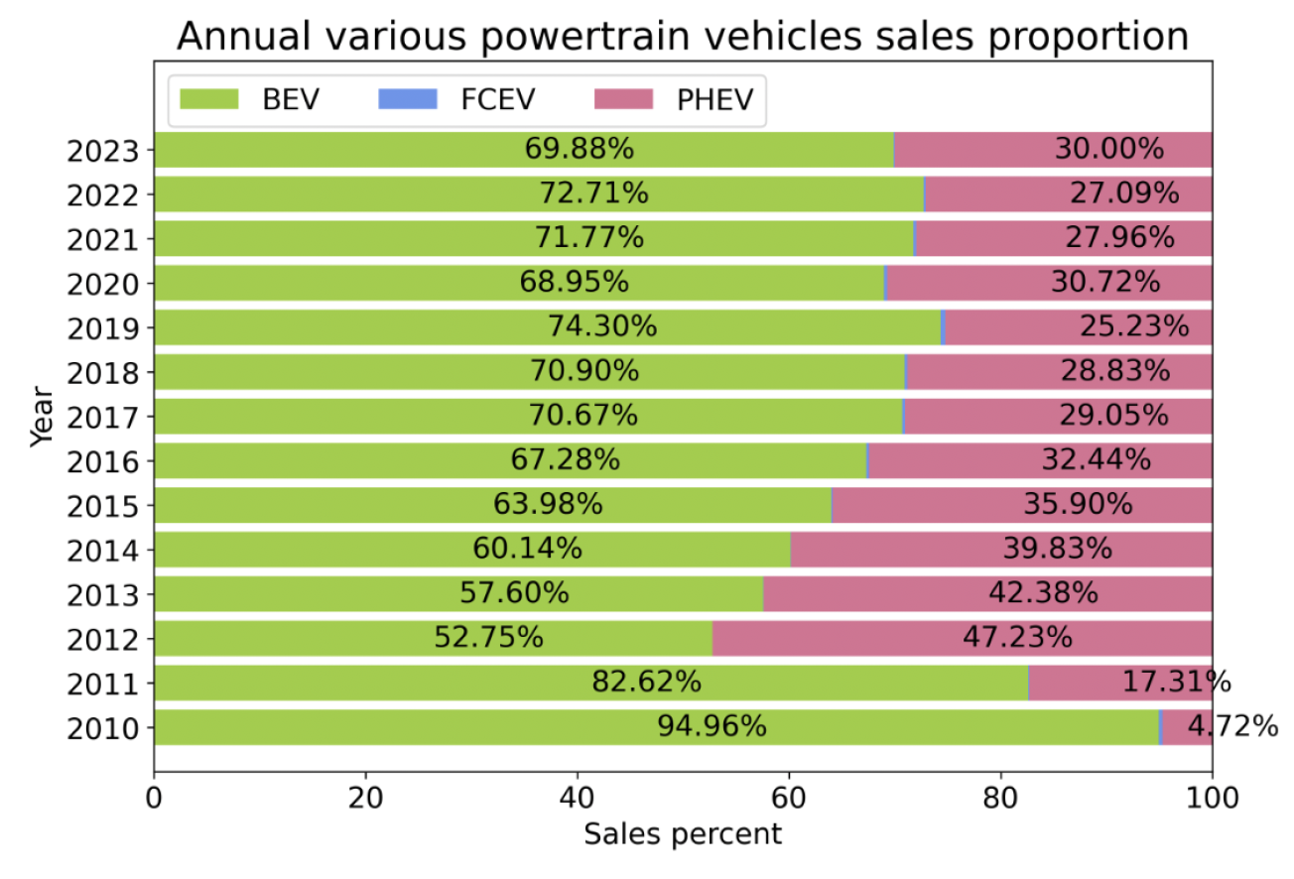
Sales Trend

Slide 15
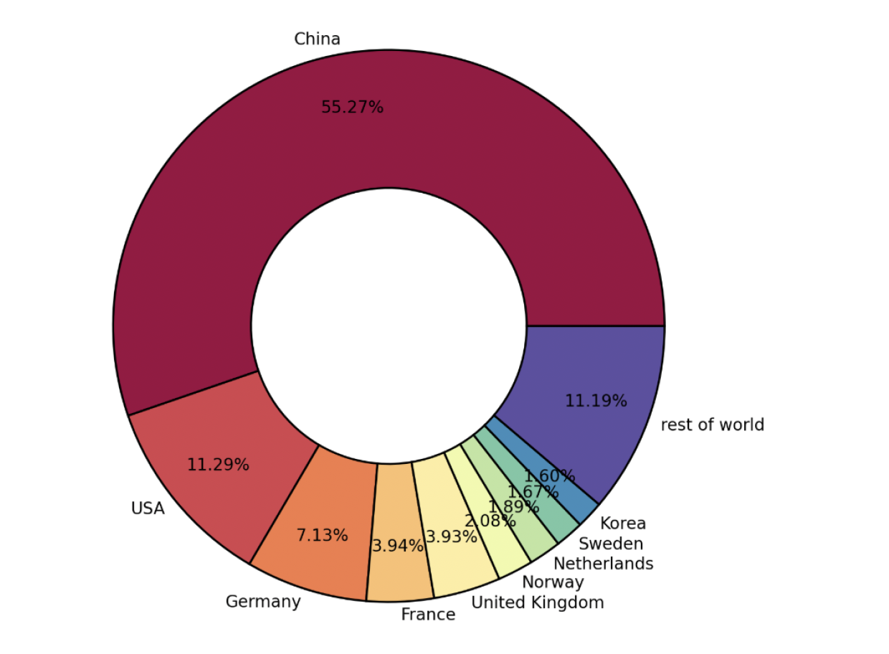
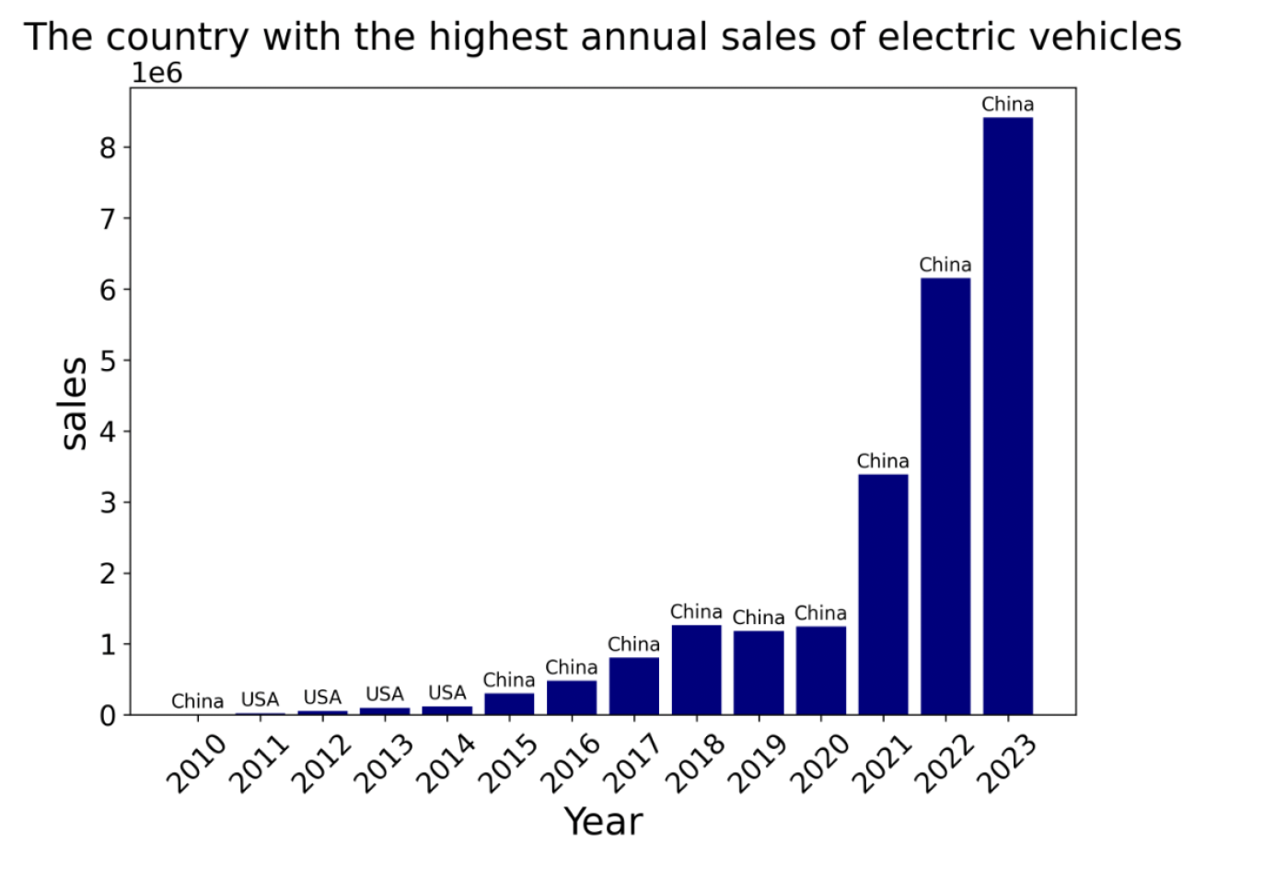
Annual Sales by Country

Slide 16
FUTURE DIRECTIONS
Incorporation of Emerging Data Sources
Exploration of FCEVs and Alternative Powertrains
Regional Market Segmentation

Slide 17
CONCLUSION
The integration of machine learning and ARIMA/SARIMA models has shown the potential for effective forecasting of EV market trends. Some of the findings are :
Dominance of BEVs and steady growth of PHEVs.
China's leading role in global EV adoption, driven by favorable policies and technology advancements.
Further exploration of underperforming segments like FCEVs to address adoption barriers.
Conclusive insights from the study will aid manufacturers, policy changes, and other stakeholders in key decisions making positions to ensure further, sustainable growth for the EVs market.

Slide 18


THANK YOU
utmofficial
univteknologimalaysia
utm.my

